Slide 1
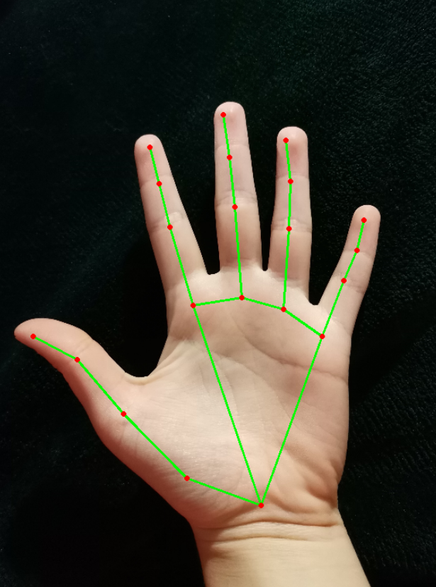
HAND GESTURE RECOGNITION FOR CONTROLLING THE BRIGHTNESS and volume OF COMPUTER
TEAM MEMBERS
RAKSHIT CHAJJED (201IT146)
ADITYA RAMA HEGDE (201IT105)
SATYAM VATS (201IT156)
SAURAV KUMAR (201IT157)

Slide 2
INTRODUCTION
As we know, the vision-based technology of hand gesture recognition is an important part of human-computer interaction (HCI).
Hand Gesture can be used as a tool of communication between computer and human . It is greatly different from the traditional hardware based methods and can accomplish human-computer interaction through gesture recognition.
Hand Gesture recognition determines the user intent through the recognition of the hand gesture . In the past decades, many researchers have strived to improve the hand gesture recognition technology.
Hand gesture recognition has great value in many applications such as sign language recognition , augmented reality (virtual reality) , sign language interpreters for the disabled , and robot control .

Slide 3
PROBLEM STATEMENT
In this era of technological revolution, where everything is becoming automated, the physical touch between the system and the user is also becoming redundant. The concept of Gesture Recognition using various methods has widely been studied. This project aims to provide comprehensive research on the topic of Hand Recognition using python by employing the frameworks of OpenCV libraries.
The main aim of this project is to provide the users with a way to operate their system in a more efficient and appealing manner. A hand gesture recognition system requires only a webcam can give way to many more such works making this more efficient with days to come.

Slide 4
METHODOLOGY
We have used the media pipe framework to detect the hand gestures.
We also have used the OpenCV library for image processing.
It will detect hand landmarks.
Our python code will be calculating the distance between thumb and the index finger and giving the respective brightness of the computer.
Also it will be calculating the distance between thumb and the little finger giving the respective volume of the computer.
Maps the distance of the thumb tip and the index finger tip with the brightness range.
Also maps the distance of the thumb tip and the little finger tip with the volume range.

Slide 5
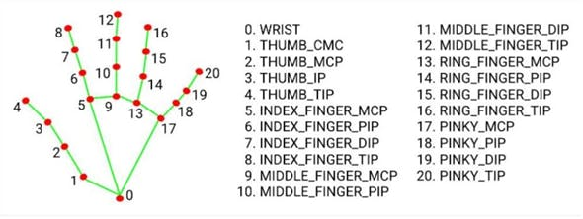

Slide 6
RESULTS
OBSERVATIONS
After running the python code, we will be getting the interface displaying webcam.
As the distance between the fingers decrease, the brightness and the volume of the computer decreases and vise-versa.

Slide 7
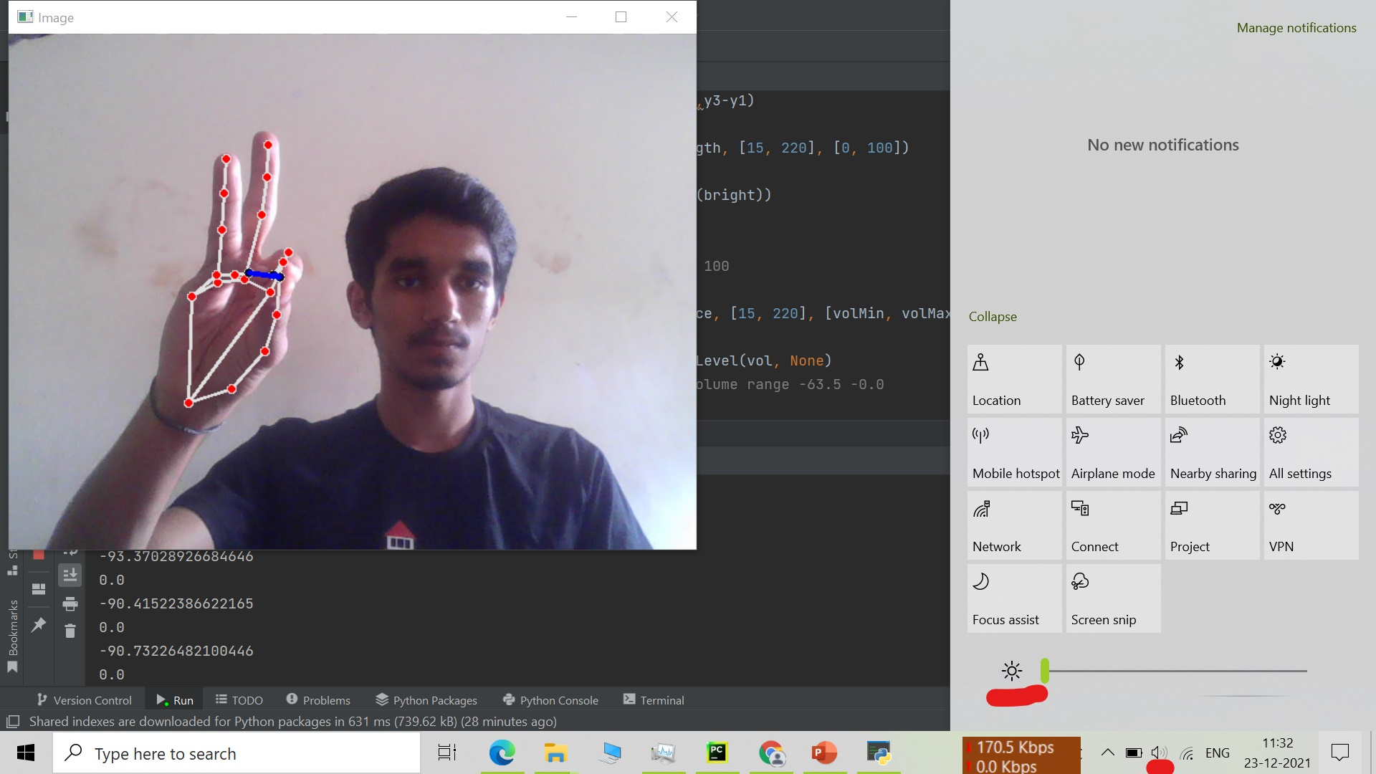
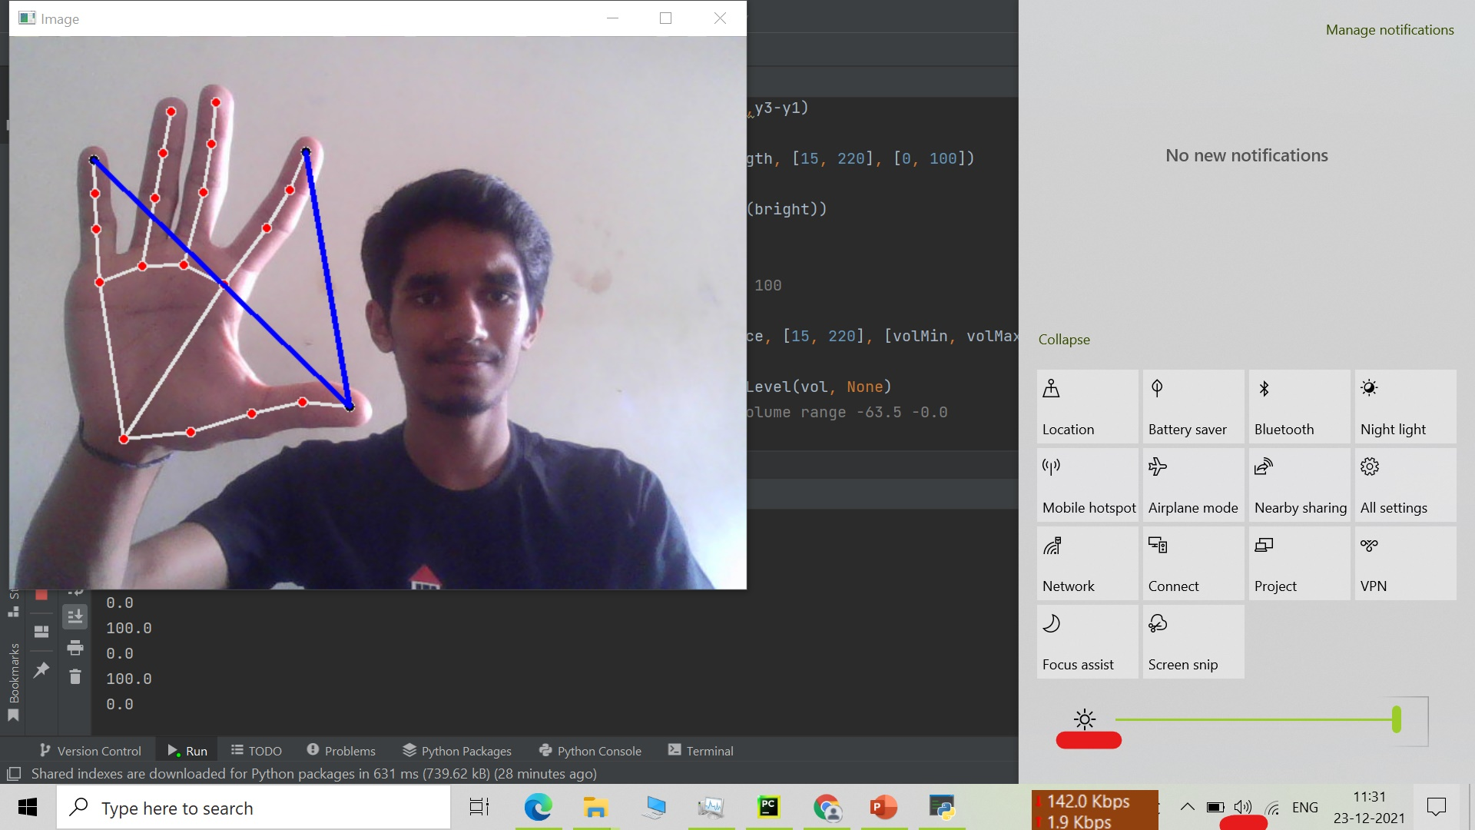
COMPARISONS

Slide 8
conclusion
Gesture recognition helps computers to understand human body language. This helps to build a more potent link between humans and machines, rather than just the basic text user interfaces or graphical user interfaces (GUIs).
In this project for gesture recognition, The fingers motions are read by computer camera. The computer then makes use of this data as input to handle applications.
In this Python OpenCV Project also includes a downloadable source code for free.

Slide 9
references
An article from researchgate:-https://www.researchgate.net/publication/284626785_Hand_Gesture_Recognition_A_Literature_Review
An article from huckster website:-
https://www.hackster.io/as4527/volume-control-using-hand-gesture-using-python-and-opencv-7aab9f
Novelty:-We have made both the brightness and volume in the same project.
THANK YOU

